Slide 1
Welcome & Introduction to
Founded in 2000
www.groundangels.org
www.GroundAngels.org
a Houston based non-profit group
Prepared by Derek King
January 2024
Notes:
Who am I ?
Volunteer since ??
My cancer/family experience
Why am I telling you this - We need volunteers to gift that most precious resource - time and compassion.
Of course - donations are welcome – but again – We need Volunteers.

Slide 2
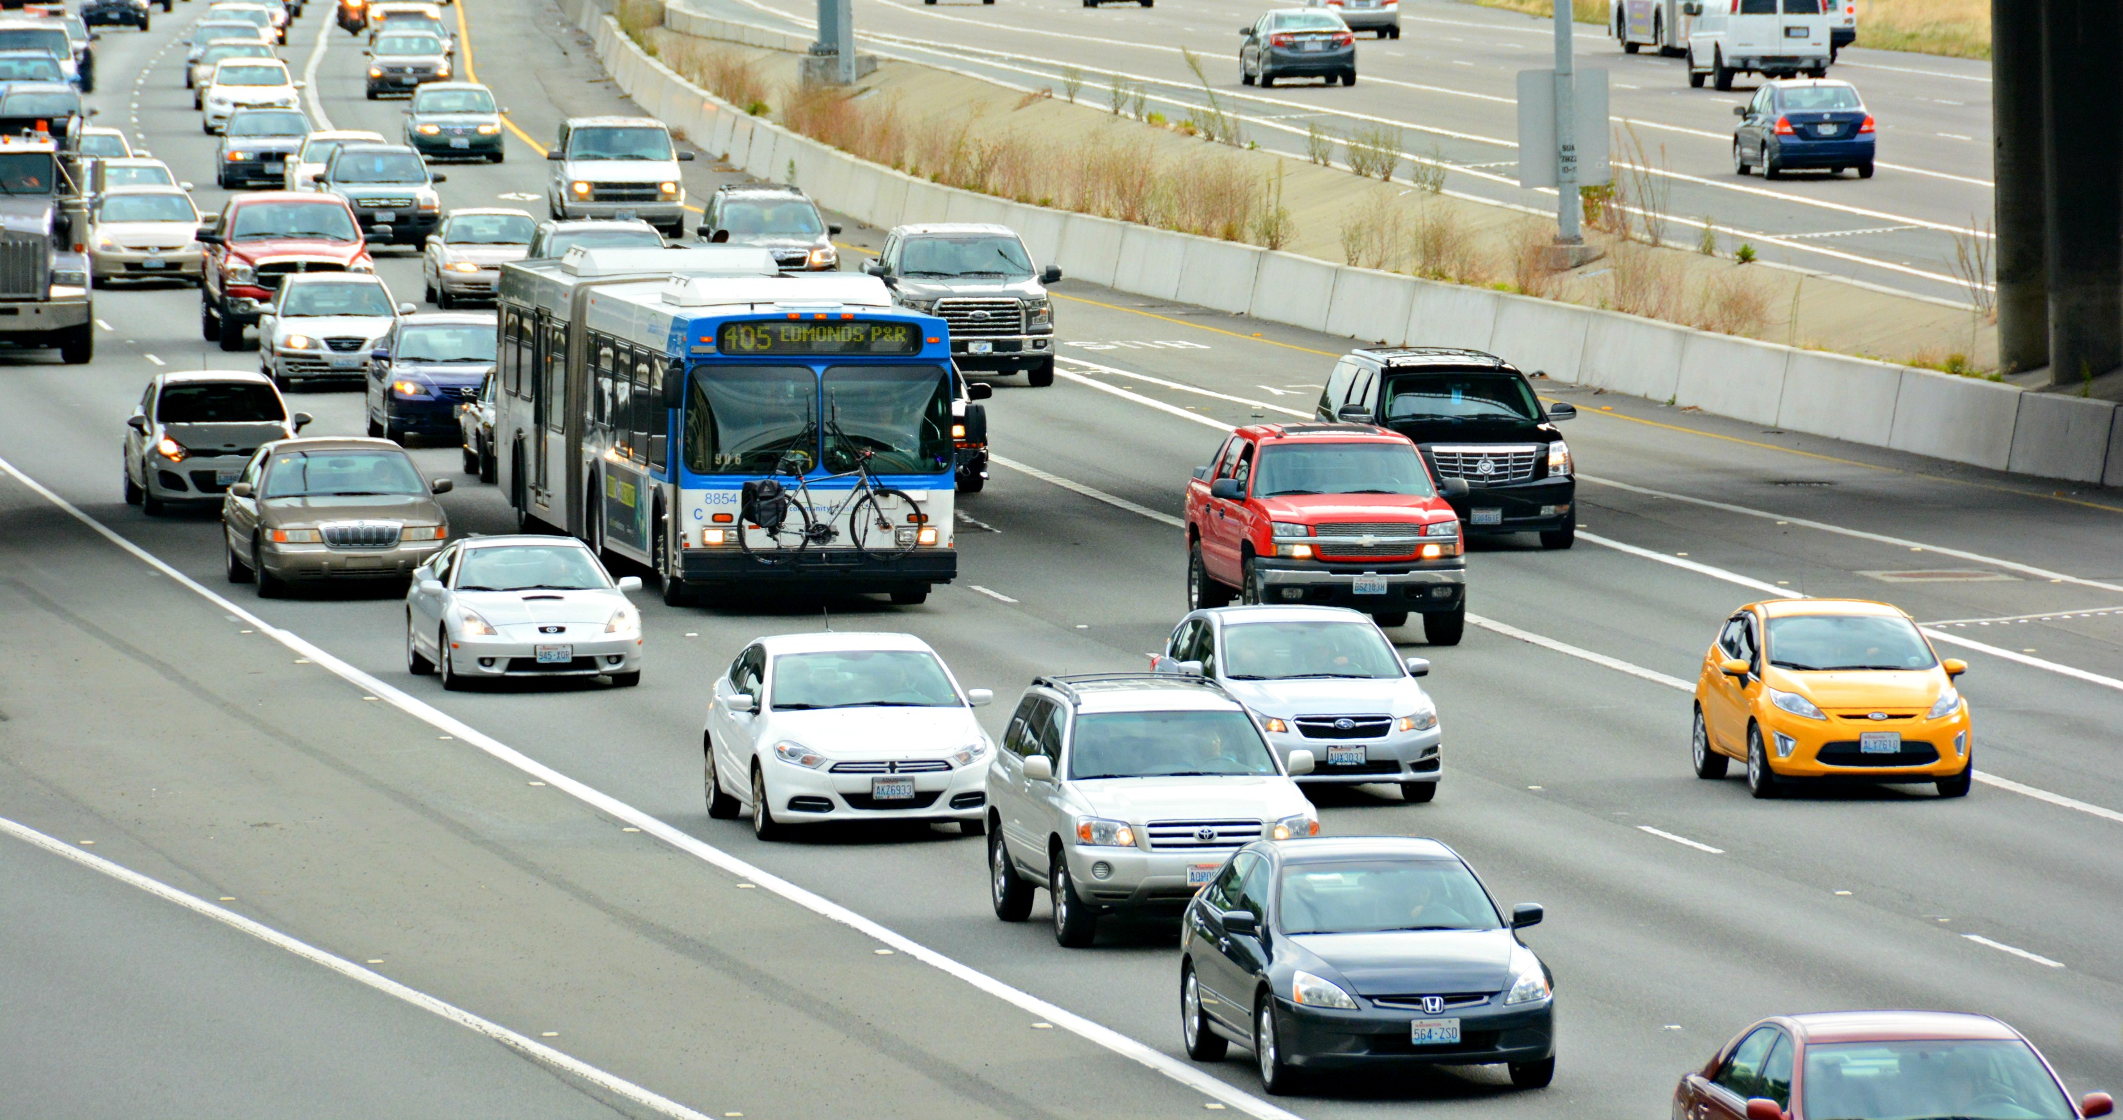
VOLUNTEER DRIVERS NEEDED
HOUSTON GROUND ANGELS
This Photo by Unknown Author is licensed under CC BY
Notes:
Houston’s Medical Center is a world renown group of over 19 hospitals that treat the most challenging medical conditions. Patients travel from all over the country to see the most skilled specialists.
Patients travel by car and plane – even by train to get to their treatment – many from far away.
Local patients get diagnosed in their local clinics but get passed forward to the Texas Med Center or a remote facility for their critical care – often multiple treatments over many months.
I meet many patients who live in REALLY remote places – from a farm – go to town once a week – and now they need to come to Houston. Drove 14 hours the first time – got lost – wiped out with the stress. Now they have to come once a month for over a year – fly to Bush or Hobby airport – ladies on their own – just cannot afford to buy two air tickets.
Some local patients are unfortunately confined to their home. All need our help.

Slide 3
Providing caring and compassionate rides
Do you have about 1 to 3 hours to provide transportation for a cancer patient to and from a local clinic or the Texas Medical Center ?
HGA needs driver Volunteers !
Notes:
Major airlines and “angel” pilots get the flying patients to the airport, but Ground Angels are needed to get them to their hospital or treatment facility.
There are 17 airports around the Houston area that we serve. Mention your local airports – eg: Hooks, Conroe and Bush are local to us here in NW Houston.
Local patients who cannot drive or whose treatment has affected their health need pick up from home and transport to or from the hospital.
Some local patients are treated at Willowbrook, the Woodlands, Kingwood and at Cypress hospitals.
We can only get around 70% of requests

Slide 4
We move patients to and from the Texas Medical Center and clinics across the Houston area. From their homes and also those flying in for critical treatment
Notes:
Our volunteers meet all sorts of people who are on serious medical journey’s.
Some patients are going to treatment every two weeks or once a month. Many are in medical trials. Those in remission may have to come – just every six months or annually.
Many ladies travel solo due to the expense of air fares – and welcome a friendly and compassionate driver – rather than an Uber or the Metro bus system.
All are anxious about their treatment plan and uncertain how to get where they need to be. Ground Angels are a boost to their wellbeing.
All our drivers gift their time and vehicle costs to help the patient. There are no fees to the patient.

Slide 5
We are a registered Non-Profit, 501 (c-3) organization established in 2000.
Volunteers pick a time that is most convenient for them to select a mission. Every mission fulfills a great need and is truly appreciated for all those we serve.
Our secure website provides logged in volunteers with specific mission data such as day, time, passenger details, pick up and drop off locations.
The volunteer’s gift to the patient is their time and expense to safely complete one part of their treatment journey.
Notes:
All open ride requests are listed on a web “Bulletin Board” – we call each ride a mission.
Volunteers choose from listed “ride requests” on a secure website. Entirely a free choice – which rides to take.
Just under half our drivers are ladies – this is not a man thing.
No obligation to do anything – you look – you choose.
We do ask volunteers to take one ride a month – is that too much?
You know you are doing a good thing – one ride at a time.

Slide 6
Picking up at 17 small airports around the Houston metro area and from Hobby/Bush. We meet angel flights every day.
Pilot, Patient and companion, Ground Angel driver
Notes:
Private pilot groups donate their time and plane expenses to get patients to one of 17 airports around the Houston area.
Those patients are often from very small rural areas – a long distance from a major airport.
They arrive and get off the plane – where are we ? – Where’s the hospital ?
Rental car – hotels – meals – Taxi or Uber. Will we be safe? What will this cost ?
Over 4400 flight mission requests in 2023 – over 3650 successful rides given.
That’s an average of ten a day. – but we were unable to get 750 patients.

Slide 7
Around 3000 patients a day enter the doors of the Texas Medical Center, travelling from all over North America.
Arriving in Houston can be a daunting prospect; finding and getting directions, the traffic and the travel expense ($80-100 one way) plus hotel and medical expenses.
Patients may be here for just one day
or sometimes for weeks, and often
have to make many return treatment
visits.
This Photo by Unknown Author is licensed under CC BY-NC
Notes:
All our patients must be able to get in and out of the volunteers vehicle.- but a gentle hand is always appreciated. Normally it is one patient/family per trip. One way only.
Air patients are dropped off either direct to clinics or a nearby hotel. Ground Angels do not do hotel to clinic trips – as the Med Center and most hotels have a shuttle service.
Inbound local patient riders are picked up at home and dropped at clinics or vice versa – again just one patient per trip. We are not a bus service.
We do not ask – but many patients will share their stories – lost their job – getting a home equity loan to pay for extended treatment – distressed family finances. No relatives nearby who might help.

Slide 8
Our volunteers provided 4600+ rides in 2023. Local patient requests are increasing.
MDA drop off - Ground Angel driver and Patient
Notes:
Our Non-Profit is GOLD rated by CANDID – GuideStar
Houston Ground Angels have been blessed to be featured on Houston Life (KPRC) – Great Day Houston (KHOU) – Volunteer Vibes (FOX 26) which resulted in a large increase in local ride requests. But just a few new volunteers.
Our most active volunteers make 2-3 rides a day – they live in the Hobby airport area.
We REALLY need volunteers to just take one or two rides a month – could you do that?

Slide 9
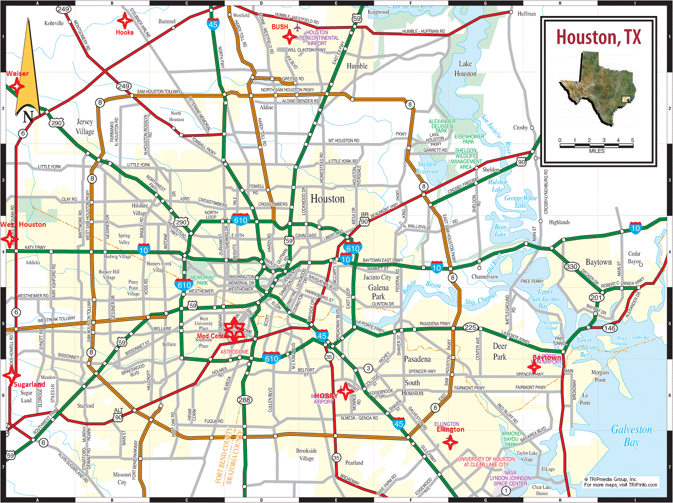
Hobby and Bush are the main airports, but private planes fly in and out to a number of small airfields
Notes:
IAH Bush & Hobby are the main airports.
Total mission trip time is around 2½ hours depending on traffic.
Some “angel ” flights arrive at Hooks from nearby states and west Texas.
Many patients travel on their own, or are accompanied by a relative – sometimes a caregiver. Child with a parent etc.
Other airports – Ellington, Sugarland, Baytown, West Houston, Brazoria County.

Slide 10
Volunteers pick rides at times of their choosing. All on a secure message board. Just one ride a month – makes a difference
2020 Volunteer of the Year presentation
Notes:
All Houston Ground Angels operating costs are supported by public donations, bequests from grateful families and gifts from some patients who have used our services.
We have one full time and one part time paid employee.
Web site and mission request system provides nearly all information for every patient and all our volunteers.
System patient and volunteer management is provided seven days a week and most all day – limited overnight. Our staff are REALLY dedicated.
We have no physical office – saves on expenses.
ALL Board members are volunteers and unpaid.

Slide 11
Houston Ground Angels (HGA) needs to increase driver volunteers to maintain our mission.
Volunteers who provide just one or two rides per month make a significant contribution to our success. Every ride is highly appreciated by the Patients in need.
New driver Volunteers can be mentored by existing drivers to help them get started. CONTACT us to discuss your availability and sign up to provide this caring and worthwhile service.
Notes:
We welcome donations of any amount
Our staff have access to a discretionary fund for emergency situations -
To provide an UBER if patient is financially distressed
When a volunteer has committed to carry – but cannot show up, is delayed, taken ill or has a vehicle breakdown
Emergency food delivery.
Larger donations can be designated by donor for specific purposes.
New volunteer outreach
Gas Cards for volunteers
Volunteer hospitality
Volunteer recognition

Slide 12
We show visitors to Houston and community residents in challenged circumstances the best of Houston – by getting them to their critical treatment Please consider joining us as a volunteer driver
www.groundangels.org
Notes:
I welcome any questions from y’all - please speak up……now
Please take a bookmark – be reminded to view our website and consider how you can help.
Please join us – we need Volunteers
If you need to speak to me personally, please do so.
Thank you for your attention

